Slide 1
BRAIN TUMORS CLASSIFICATION USING DEEP LEARNING ALGORITHMS
PRESENTED BY,
N.PRASANNA,
M.E., II YEAR,
813823405002.
GUIDED BY,
DR. V PUNITHA,
PROFESSOR & HEAD OF THE DEPARTMENT.

Slide 2
OBJECTIVES
Develop an accurate deep learning system for automated detection and classification of brain tumors from MRI images to aid healthcare professionals in diagnosis and treatment planning.
Gather a dataset of brain MRI images, including normal scans and various types of tumors (Glioma, Meningioma, Pituitary).
Implement preprocessing techniques like normalization, noise reduction, contrast enhancement, and data augmentation.
Design and implement multiple deep learning architectures (e.g., VGG16, ResNet50, Inception V3).
Optimize model parameters for high accuracy, reduced errors, computational efficiency, and real-time processing.

Slide 3
MOTIVATION
There are many state-of-the-art deep learning models that have been developed in recent years. Some of the most popular models are:
Visual Geometry Group16 (VGG16)
Inception V3
Deep Residual Network (ResNet-50)
Deep Belief Network (DBN)
Deep learning algorithms can handle large datasets, which is often necessary for training high-performance image classification models.

Slide 4
Literature Survey
S.No: | EXISTING SYSTEM | DRAWBACKS
01. | Multimodal data fusion of adult and pediatric brain tumors with deep learning This paper investigates the use of multi-model deep learning to enhance survival predictions for pediatric brain tumor patients by integrating imaging data (Whole slide images) and genomic data (gene expression). It highlights the shortcomings of traditional single-source data approaches in accurately forecasting patient outcomes. The study also emphasizes the need for interpretability in predictive models, proposing pathway analysis as a method to understand the underlying biological mechanism, and suggests the future research should be explore incorporation more diverse data types to improve prediction accuracy. | Complexity of the Model: may result in challenges related to model interpretability and increased computational demands. Limited Data Types: it acknowledges that incorporating additional data indicating that the current model may not fully capture all relevant biological information.

Slide 5
02. | A Deep Learning-Based Framework for Automatic Brain Tumors Classification Using Transfer Learning The paper explains a brain tumor classification and detection system using deep learning techniques, specifically convolutional neural networks (CNNs). It details the methodology, including the CNNs employed, and the experimental design and results. Additionally, it discusses related work, the effectiveness of transfer learning, and the performance evaluation of the proposed system compared to existing methods. The brain tumor classification system that utilizes T1-weighted contrast-enhanced MRI images from 233 patients with various brain tumors. The system employs three pretrained CNN architectures AlexNet, GoogleNet, and VGGNet. | The paper highlights that existing automated tumor detection systems do not provide satisfactory outputs, indicating a need for more robust computer-aided diagnosis systems. Additionally, manual feature extraction, which can degrade accuracy and efficiency. The challenges in tumor classification due to the heterogeneity and varying properties of tumors also pose significant difficulties.

Slide 6
03. | A Deep Learning Model Based on Concatenation Approach for the Diagnosis of Brain Tumor This abstract discusses the challenges of classifying brain tumor using MRI, highlighting the distinction between normal and abnormal tumors, as well as the complexities of categorizing different tumor types. It emphasizes the limitation of conventional feature extraction methods and the advantages of deep learning models, particularly CNNs, in automatically extracting relevant features for improved classification. Additionally, it notes the importance of computer-aided diagnosis (CAD) system in assisting neurologists with tumor grading, classification, and detection | Additionally, these models can be prone to overfitting, especially when trained on small datasets, leading to poor generalization on unseen data. deep learning and machine learning in brain tumor classification include the need for large labeled datasets, which can be difficult and time-consuming to obtain.

Slide 7
04. | Detection of tumors on brain MRI images using the hybrid convolutional neural network architecture In this paper, the author discusses the significance of early detection of brain tumors, which are abnormal tissue growths in the brain. It highlights the use of MRI images deep learning methods for classifying these tumors, emphasizing the importance of training networks with large databases to improve diagnostic accuracy rate 86.56% using a convolutional layer and primary capsules for image classification. | This can lead to reduced accuracy in real-world applications. Additionally, the reliance on large annotated datasets for training can be a limitation, as acquiring such data can be time-consuming and resource-intensive.

Slide 8
Proposed System
This system involves outlining the components, functionalities, and architecture of a system that is planned for implementation. Let's sketch a high-level design for a deep learning-based brain tumor detection system using models like
Inception v3,
VGG-16,
ResNet-50,
Deep Belief Networks (DBNs)
Collect MRI Images: Gather a dataset of brain MRI images with labeled tumor types (e.g., gliomas, meningiomas, pituitary tumors).
Preprocess Images: Resize images to the required input size (224x224 for VGG-16 and ResNet-50, 299x299 for Inception v3). Normalize pixel values and apply data augmentation techniques like rotation, flipping, and scaling to increase dataset diversity.

Slide 9
System Architecture
Brain tumor images
Data Processing
Data Collection
Classification
VGG-16
Inception V3
ResNet-50
Deep Belief Network
Result
Tumor
No
Yes
Tumor
End
Accuracy in algorithm

Slide 10
Flow Diagram:
Data Set
Preprocessing
Model
Training
Training Phases

Slide 11
Deep Learning
Deep learning is a method in artificial intelligence (AI) that teaches computers to process data in a way that is inspired by the human brain. Deep learning models can recognize complex patterns in pictures, text, sounds, and other data to produce accurate insights and predictions. The adjective "deep" refers to the use of multiple layers in the network. Methods used can be either supervised, semi-supervised or unsupervised.

Slide 12
ResNet-50
ResNet-50 stands for Residual Network with 50 layers. It is built on the concept of residual learning, which helps in training very deep networks effectively.
The network consists of 5 stages, each with a series of convolutional layers, followed by batch normalization and ReLU activation.
Skip connections (or shortcut connections) are a key feature of ResNet-50. These connections allow the gradient to flow through the network more effectively, addressing the vanishing gradient problem
Residual Blocks: These blocks allow the network to learn residual functions with reference to the layer inputs, making it easier to train deeper networks.
Skip Connections: These connections help in preserving the information from earlier layers, which improves the learning process.
Deep Network: ResNet-50 can have up to 50 layers, which allows it to learn more complex features from the input data.

Slide 13
Inception V3 Convolutional Neural Network (CNN)
Inception Modules: The architecture is built using multiple inception modules, which are small networks within the larger network. Each module performs several convolutions of different sizes (1x1, 3x3, 5x5) in parallel2.
Factorized Convolutions: Instead of using large convolutions directly, Inception V3 uses factorized convolutions (e.g., splitting a 7x7 convolution into two 3x3 convolutions) to reduce computational cost.
Auxiliary Classifiers: These are added to the intermediate layers to help with training by providing additional gradient signals.
Batch Normalization: This technique is used to normalize the input of each layer, which helps in stabilizing and speeding up the training process.
Label Smoothing: This technique helps in improving the model's generalization by preventing the model from becoming too confident about its predictions.
Efficiency: Despite being deeper and more complex than its predecessors, Inception V3 is designed to be computationally efficient.
Versatility: It can be used for various tasks such as image classification, object detection, and more.

Slide 14
(VGG16) Visual Geometry Group-16
Layers: VGG16 consists of 16 layers, including 13 convolutional layers and 3 fully connected layers. The network follows a very straightforward and uniform structure, using only 3x3 convolutional filters and 2x2 max-pooling layers.
Depth: This depth allows VGG16 to capture more complex patterns and features from the input images.
Sequential Model: Unlike more complex architectures with inception modules or residual connections, VGG16 uses a sequential model where each layer is stacked on top of the previous one.
Simple Design: The simplicity and uniformity of using 3x3 convolutional filters make the architecture easy to understand and implement.
Transfer Learning: VGG16 is often used for transfer learning, where the pre-trained model on large datasets like ImageNet is fine-tuned for specific tasks.
High Performance: Despite its simplicity, VGG16 has achieved strong performance in image classification tasks and other vision-related applications.

Slide 15
Deep Belief Network (DBN)
Multiple Layers: DBNs consist of multiple layers of hidden units. Each layer learns to represent the data in a more abstract way than the previous one3.
Restricted Boltzmann Machines (RBMs): The layers in a DBN are typically composed of RBMs, which are unsupervised learning models that learn to reconstruct the input data.
Stacked RBMs: DBNs are essentially stacks of RBMs, where the hidden layer of one RBM serves as the visible layer for the next RBM.
Generative Model: DBNs can generate new data samples that are similar to the training data, making them useful for tasks like image generation and anomaly detection.
Feature Extraction: They are effective at learning complex, high-level features from data, which can be useful for tasks like classification and clustering.
Layer-wise Training: Training DBNs layer-by-layer helps in better initialization of weights, which can lead to faster convergence during the fine-tuning phase
Accuracy: The proposed method produced 100 % testing accuracies respectively with DBN testing samples and achieved highest performance in the detection of brain tumor.

Slide 16
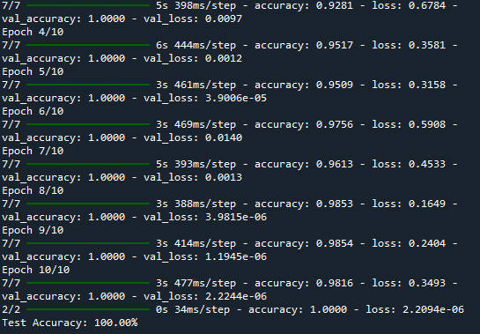
Output

Slide 17
PERFORMANCE METRICS
The performance metrics used to evaluate the model are Accuracy, Precision, Recall and Confusion Matrix for visual representation.
Accuracy: is one of the simplest Classification metrics to implement, and it can be determined as the number of correct predictions to the total number of predictions.
Precision: determines the proportion of positive prediction that was actually correct. It can be calculated as the True Positive or predictions that are actually true to the total positive predictions (True Positive and False Positive).
Recall: it aims to calculate the proportion of actual positive that was identified incorrectly. It can be calculated as True Positive or predictions that are actually true to the total number of positives, either correctly predicted as positive or incorrectly predicted as negative (true Positive and false negative).
Confusion Matrix: A table that summarizes the number of correct and incorrect predictions by comparing the predicted and actual values.

Slide 18
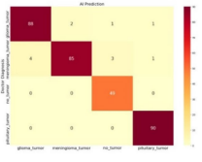
RESULTS

Slide 19
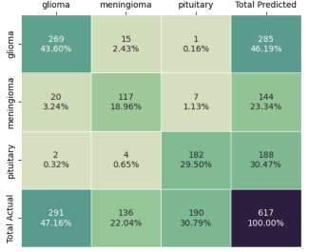
CONFUSION MATRICS FOR VGG 16 ALGORITHM

Slide 20
FEATURES IDENTIFICATION
FEATURES | VGG 16 | Inception V3 | ResNet50
Grid-based Detection | YES | NO | NO
Bounding Box Prediction | YES | NO | NO
Real-time Detection | YES | NO | NO
Hierarchical Features | NO | YES | YES
Convolutional Layers | NO | YES | YES
Skip Connections | NO | NO | YES
Transfer Learning | NO | YES | YES
Multi-class Classification | YES | YES | YES
Efficient Parameter Optimization | YES | YES | YES

Slide 21
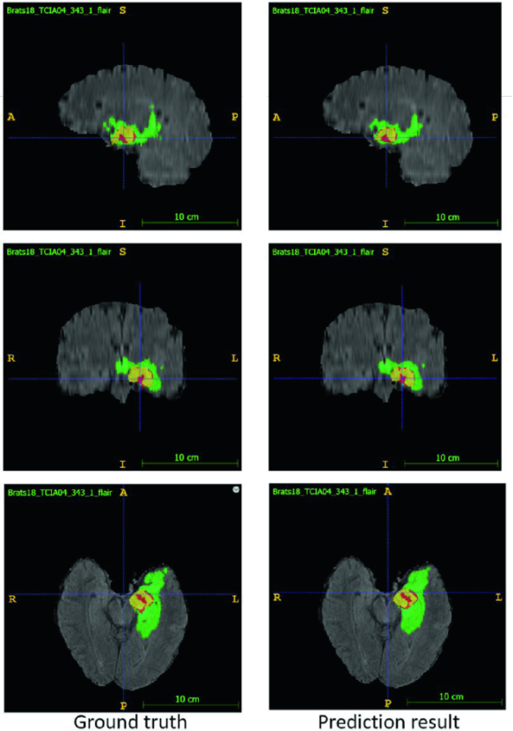
TUMOR IMAGES IDENTIFICATION

Slide 22
CONCLUSION AND FUTURE WORKS
The proposed system design for brain tumor detection includes steps such as data collection, preprocessing, model training, evaluation, and deployment. Each step ensures the system is accurate, efficient, and robust.
Enhanced Data Augmentation: Implementing more sophisticated data augmentation techniques can help in creating a more diverse dataset, which can improve model generalization.
Multi-Modal Data Integration: Integrating different types of data (e.g., MRI, genetic data, clinical records) can provide a comprehensive understanding of brain tumors, leading to better predictions.
Transfer Learning: Using pre-trained models on large medical datasets and fine-tuning them for specific tasks can save time and resources while improving performance.

Slide 23
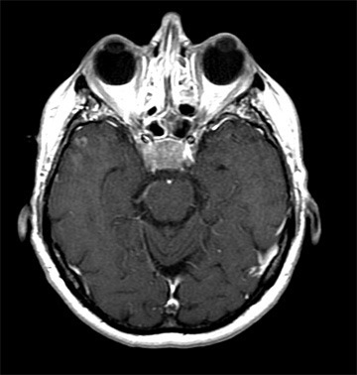
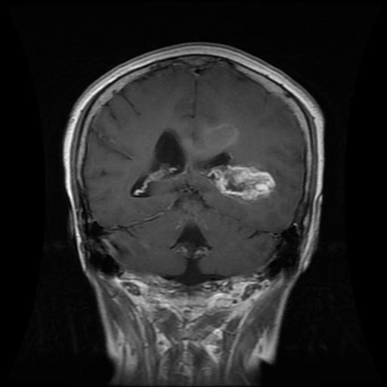
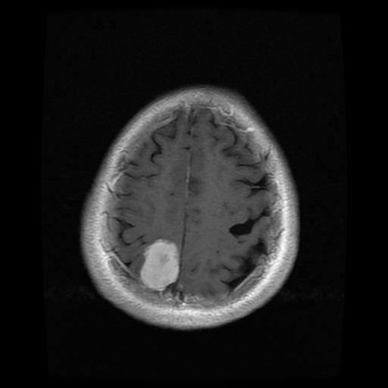
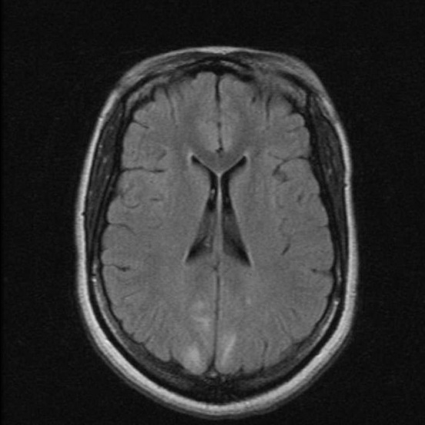
Trained Data Tumors

Slide 24
Thank younk You

